Slide 1
Relations

Slide 2
We will talk about ordered pairs and Cartesian products.
Then we will talk about relations.

Slide 3
Ordered Pair
An ordered pair of elements a and b, where a is designated as the first element and b as the second element, is denoted by (a, b).
In particular, (a, b) = (c, d) if and only if a = c and b = d. Thus (a, b) != (b, a) unless a = b.
This contrasts with sets where the order of elements is irrelevant; for example, {3, 5}={5, 3}.

Slide 4
Product of sets
Consider two arbitrary sets A and B.
The set of all ordered pairs (a, b) where a ∈ A and b ∈ B is called the product, or Cartesian product, of A and B.
A short designation of this product is A × B, which is read “A cross B.”
By definition, A × B = {(a, b)| a ∈ A and b ∈ B}
One frequently writes A² instead of A × A.

Slide 5
Example
Let A = {1, 2} and B = {a, b, c}.
Then
A × B = { (1, a), (1, b), (1, c), (2, a), (2, b), (2, c) }
B × A = { (a, 1), (b, 1), (c, 1), (a, 2), (b, 2), (c, 2) }
Also, A × A = { (1, 1), (1, 2), (2, 1), (2, 2) }

Slide 6
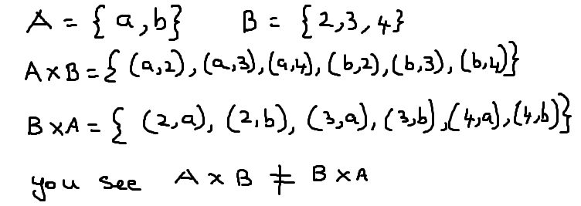
Another example

Slide 7
Two things worth noting in the examples.
First of all A×B is not same as B ×A.
The Cartesian product deals with ordered pairs, so naturally the order in which the sets are considered is important.
Secondly, using n(S) for the number of elements in a set S, we have:
n(A × B) = 6 = (2) (3) = n(A)n(B)

Slide 8
Relations (between two sets )
Let A and B be sets. A binary relation or, simply, relation from A to B is a subset of product of A × B.
Suppose R is a relation from A to B. Then R is a set of ordered pairs where each first element comes from A and each second element comes from B.
There has to be some meaningful relationship between elements of A and B

Slide 9
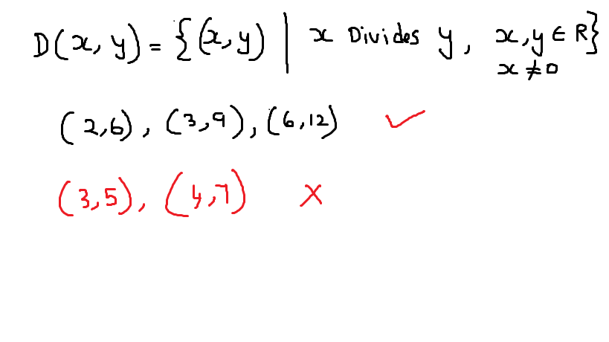
D ( x, y ) - x divides y

Slide 10
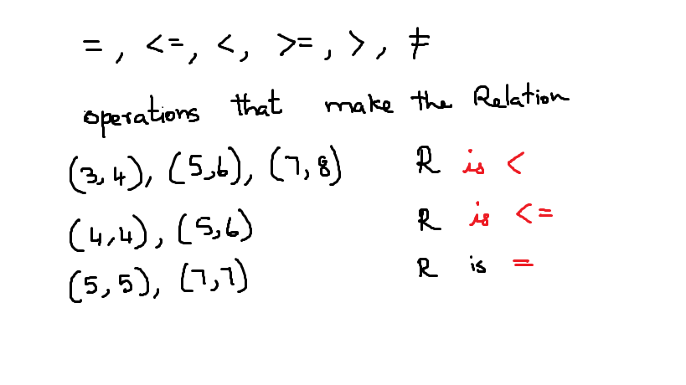
operators form a relation

Slide 11
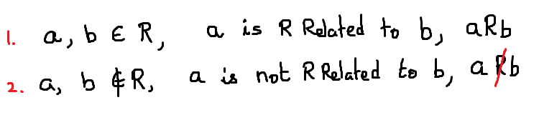
For each pair a ∈ A and b ∈ B, exactly one of the following :

Slide 12
What is Domain of a relation
Let A = {1, 2, 3}, B = {3, 4, 5}, and
R = { (1, 3), (1, 5), (3, 3) }.
Then R ⊆ A × B, so R is a relation from A to B.
Suppose R is a relation from A to B. Then the domain of R is the set
Dom(R) = { a ∈ A | ∃b ∈ B ( (a, b) ∈ R ) }.
the domain of a relation from A to B is the set containing all the first coordinates of ordered pairs in the relation. This will in general be a subset of A, but it need not be all of A.

Slide 13
Range or co-domain of a relation
Similarly, the range of a relation is the set containing all the second coordinates of its ordered pairs
The range of R is the set
Ran(R) = { b ∈ B | ∃a ∈ A ( (a, b) ∈ R) }.

Slide 14
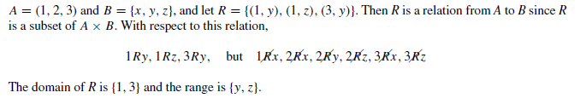
Example

Slide 15
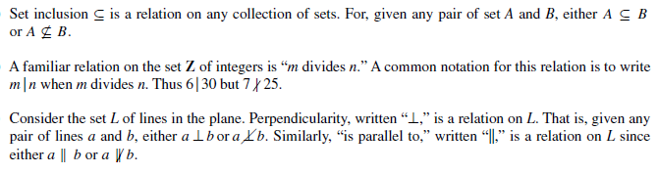
Examples

Slide 16
Example
: Let A={a, b, c, d } and B={ 1, 2}
Is relation R = { (a,1), (b,2), (c,2) , { d, 1} } a relation from A to B?
Is relation Q = { ( a , e), (d ,3 ) } a relation from A to B?
Is relation P = { (a,a), (b,c), (b,a) } a relation from A to A?

Slide 17
Inverse
The inverse of R is the relation R⁻¹ from B to A defined as follows:
R⁻¹ = {(b, a) ∈ B × A | (a, b) ∈ R}.
The inverse of a relation contains exactly the same ordered pairs as the original relation, but with the order of the coordinates of each pair reversed.

Slide 18
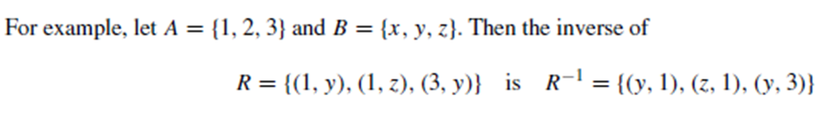
Example

Slide 19
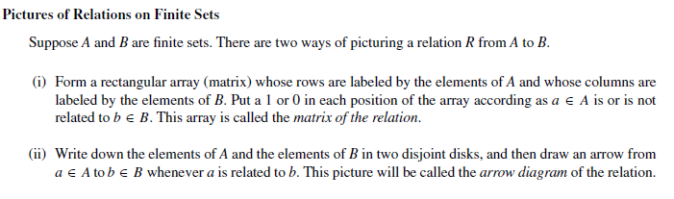
Pictorial Representation of Relations

Slide 20
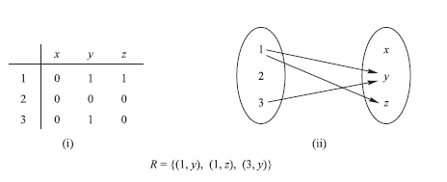

Slide 21
Digraph Definition
A directed graph, or digraph, consists of a set V of vertices (or nodes) together with a set E of ordered pairs of elements of V called edges (or arcs). The vertex a is called the initial vertex of the edge (a, b), and the vertex b is called the terminal vertex of this edge.

Slide 22
Directed Graph of the relation
There is alternate way to express relation on sets
Consider this set A = { 1, 2, 3, 4 } and
Relation R = { (1, 2) , (2, 2 ), (2, 4), (3, 2), (3, 4), (4, 1), (4, 3) }
How to draw the graph?
draw a vertex for each element in the set and label them
Connect the vertex (a, b), if (a, b) is an element in the Relation

Slide 23
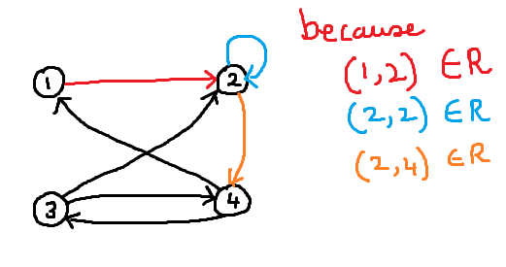

Slide 24
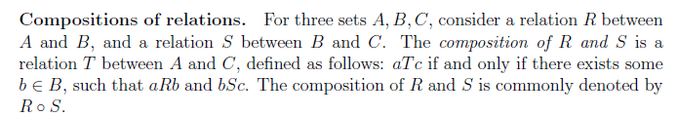
Composition of Relations

Slide 25
Composition of Relations
Let A, B and C be sets and
Let R be a relation from A to B
Let S be a relation from B to C
ie R is a subset of A x B and S is a subset of B x C

Slide 26
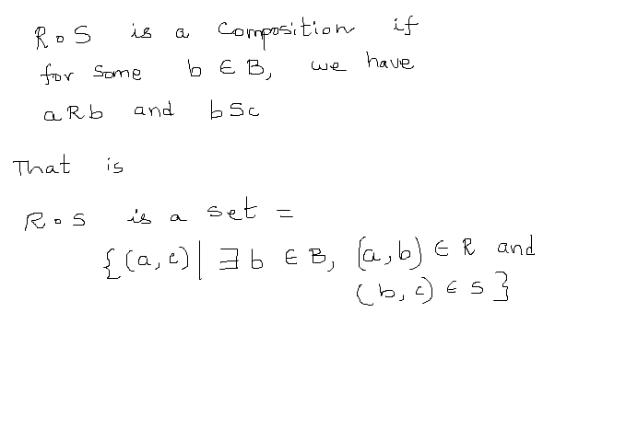
Composition

Slide 27

Example

Slide 28
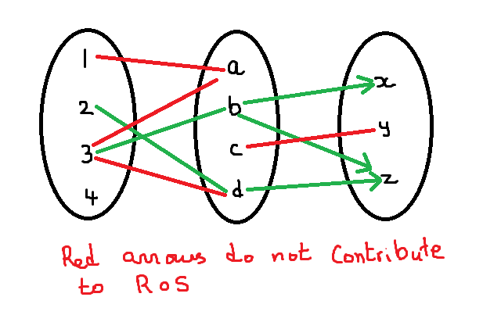

Slide 29


Slide 30
Another way to find R o S is with Matrix
Form the matrix as shown

Slide 31


Slide 32
Types of Relations
Reflexive
Symmetric and asymmetric
Transitive
equivalence

Slide 33
Relations - Reflexive
A relation R on a set A is reflexive if aRa for every a ∈ A
that is, (a, a) ∈ R for every a ∈ A.
Thus R is not reflexive if there exists a ∈ A such that (a, a) not element of ∈ R.

Slide 34

Relation - Reflexive

Slide 35
Relation - Reflexive
The relation = (is equal to) is a reflexive relation on any set. Anything is equal to itself.
The relation <= on Z is also a reflexive relation as n <= n for any n member of Z.
The relation < is not reflexive on Z.
A relation is reflexive if and only if its graph contains the line y = x.

Slide 36
Consider the following five relations on the set A = {1, 2, 3, 4}:
R1 = { (1, 1), (1, 2), (2, 3), (1, 3), (4, 4) }
R2 = { (1, 1), (1, 2), (2, 1), (2, 2), (3, 3), (4, 4) }
R3 = { (1, 3), (2, 1) }
R4 = ∅, the empty relation
R5 = A × A, the universal relation

Slide 37
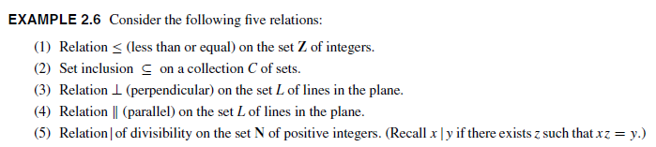

Slide 38
Symmetric
A relation R on a set A is symmetric
if whenever aRb then bRa, that is, if whenever(a, b) ∈ R then (b, a) ∈ R.

Slide 39
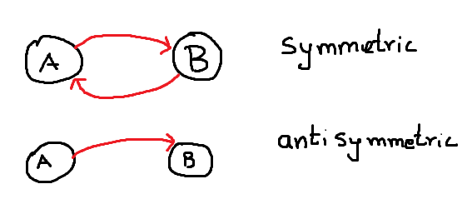

Slide 40
Reflexive - Symmetric
The relation = is symmetric on any set as if x = y then y = x is a basic property of equality
The relation on Z is not symmetric as 3 divides 6 but 6 doesn't divide 3.
Similarly, the relation < is not symmetric on Z. 3 < 6 is true, but 6 < 3 is not true
A relation is symmetric if and only if its graph is symmetric about the line y = x.

Slide 41
Consider the following five relations on the set A = {1, 2, 3, 4}:
R1 = { (1, 1), (1, 2), (2, 3), (1, 3), (4, 4) }
R2 = { (1, 1), (1, 2), (2, 1), (2, 2), (3, 3), (4, 4} )
R3 = { (1, 3), (2, 1) }
R4 = ∅, the empty relation
R5 = A × A, the universal relation
R1 is not symmetric since (1, 2) ∈ R1 but (2, 1) not ∈ R1. R3 is not symmetric since (1, 3) ∈ R3 but (3, 1) not ∈ R3. The other relations are symmetric

Slide 42
Transitive relations
A relation R on a set A is transitive if whenever aRb and bRc then aRc, that is, if whenever (a, b), (b, c) ∈ R then (a, c) ∈ R.
Thus R is not transitive if there exist a, b, c ∈ R such that (a, b), (b, c) ∈ R but (a, c) not element ∈ R.

Slide 43
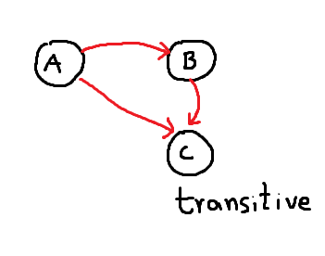

Slide 44
Relations - Transitive
The relation = is transitive on any set as if x = y and y = z then x = z is a basic property of equality.
The relations <, , >, and are all transitive on Z or R.
The relations divides is transitive on Z

Slide 45
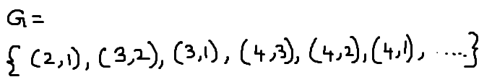
Example
Let G = {(x, y) ∈ R × R| x > y}. Then G is a relation from R to R.
Is G Symmetric ?
is G Reflexive?
is G Transitive ?

Slide 46
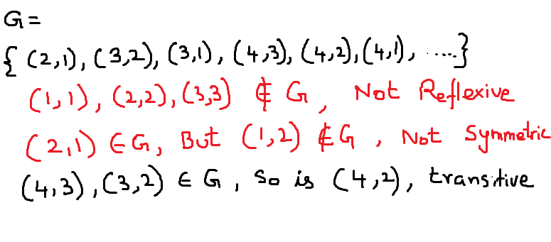
Example
Let G = {(x, y) ∈ R × R| x > y}. Then G is a relation from R to R.
Is G Symmetric ?
is G Reflexive?
is G Transitive ?

Slide 47
Example
Using this set {1, 2, 3, 4}, Consider this Relation R
{(2, 2),(2, 3),(2, 4),(3, 2),(3, 3),(3, 4)}
is symmetric, reflexive and transitive?
Not reflexive because we do not have (1, 1), (3, 3), and (4, 4).
Not symmetric because while we have (3, 4), we do not have (4, 3).
Not antisymmetric because we have both (2, 3) and (3, 2)

Slide 48
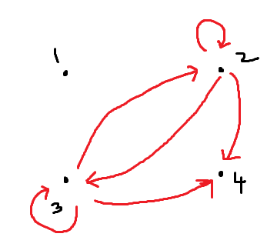
transitive because there is a path from (2, 3), (3, 2) to (2, 2)

Slide 49
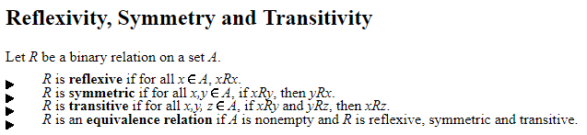
More definitions

Slide 50
In terms of digraphs,
reflexivity is equivalent to having at least a loop on each vertex;
symmetry means any arrow from one vertex to another will always be accompanied by another arrow in the opposite direction; and
transitivity is the same as saying there must be a direct arrow from one vertex to another if one can walk from that vertex to the other through a list of arrows, travelling always along the direction of the arrows.

Slide 51
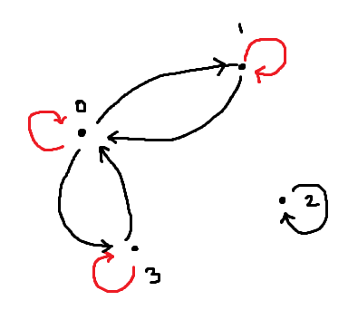
Example using digraph
Let A={ 0,1,2,3} and a relation R on A be given by
R={ (0,0), (0,1), (0,3), (1,0), (1,1), (2,2), (3,0), (3,3) }
Is R reflexive? symmetric? transitive?
It is reflexive , there is a loop at all Loop
It is symmetric
It is not transitive There is a path from (1,0)
to ( 0,3 ), but none (1,3)

Slide 52
Equivalence Relations
An equivalence relation is a relation that is reflexive, symmetric, and transitive
The most obvious equivalence relation is the relation = on any set.

Slide 53
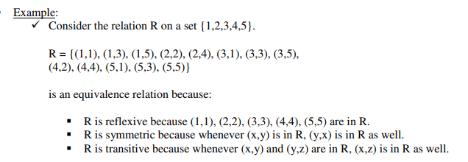
Equivalence Relations
An equivalence relation is a relation that is reflexive, symmetric, and transitive
The most obvious equivalence relation is the relation = on any set.

Slide 54
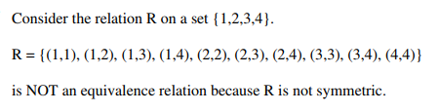
Example

